Slide 1
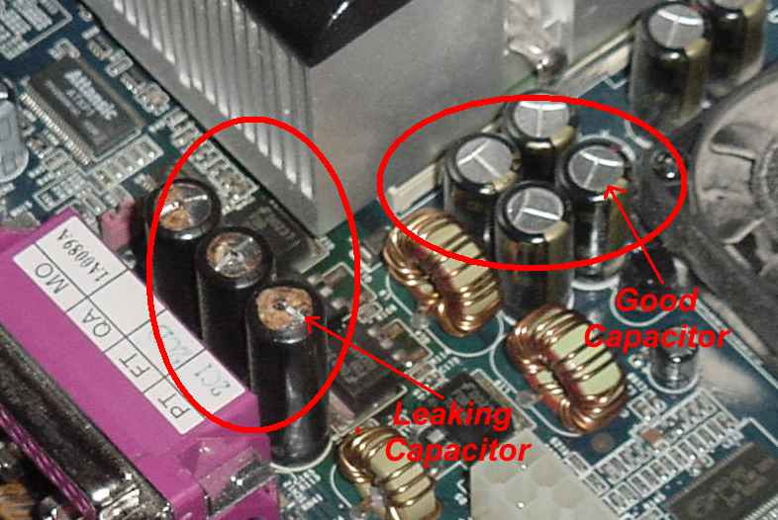
Introduction

Slide 2
Capacitors and capacitance
C = Q/V_{ab} so Q = CV_{ab}
Q increases as C is made larger, for a given pressure
more capacity means more charge stored!
Q increases as V_{ab} increases
For any particular capacitor, more pressure Vab allows it to hold more charge!
But no voltage applied means no charge stored…

Slide 3
Capacitors and capacitance
The definition of capacitance is C = Q/V_{ab}.
Units of Capacitance: [Coulombs/Volt] = FARADs
How much charge can you store per joule of work to keep them there?
But [Volt] = [Joules/Coulomb]
Farads = Coulombs²/Joule

Slide 4
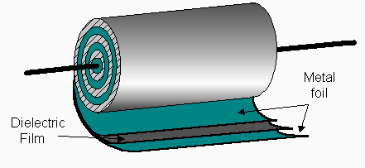
Evolution in Capacitors
Film dielectrics
“Wet” electrolytic capacitors
Ceramic Capacitors
Polymer Capacitors
Super Capacitors!
Graphene!

Slide 5
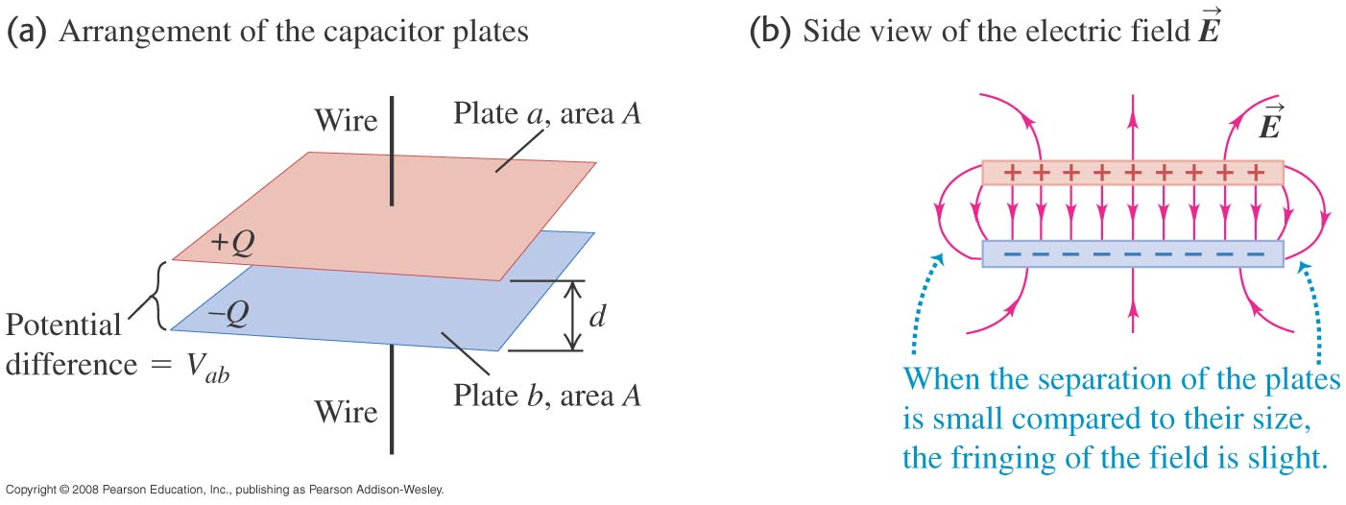
Parallel-plate capacitor
The capacitance of a parallel-plate capacitor is C = ε₀A/d

Slide 6
Parallel-plate capacitor
The capacitance of a parallel-plate capacitor is C = ε₀A/d.
Note! C is engineered! You control Area & distance by design!
C increases with Area
C decreases with separation

Slide 7
Parallel-plate capacitor
The capacitance of a parallel-plate capacitor is C = ε₀A/d.
So….ε₀ = C x d/A = [Farads x meters/meters²]
ε₀ has units of [Farads/meter]
Recall “ε₀” from Coulomb’s Law: Force = (1/4π ε₀) q₁q₂/r²
Units of ε₀ were Coulomb²/Newton-meter²
So [Farads/meter] = [Coulomb²/Newton-meter²]
[Farads] = [Coulomb²/Newton-meter]
[Farads] = [Coulomb²/Joule]

Slide 8
Parallel-plate capacitor
Example 24.2:
Plates 2.00 m² in area; 5.00 mm apart; 10 kV applied Potential Difference.
C= ε₀ A/d = 8.85 x 10⁻¹² F/m *2.00 m²/.005 m = 3.54 x 10⁻⁹ F
Q on each plate from C = Q/V so Q = CV = 3.54 x 10⁻⁵ C
E field between plates from V = Ed so E = V/d = 2.00 x 10⁻⁶ V/m
Or… E = σ/ε₀ = (Q/Area)/ε₀ = 3.54 x 10⁻⁵ C/2.00 m² / ε₀

Slide 9
Capacitors in series
Capacitors are in series if connected one after the other
Equivalent capacitance of a series combination: 1/C_{eq} = 1/C₁ + 1/C₂ + 1/C₃ + …
NOTE
C_{eq} is always LESS than the smallest capacitor in series!
Say C1 = 10 mF, C2 = 20 mF, C3 = 30 mF
1/C_{eq} = 1/10 + 1/20 + 1/30 = 6/60 + 3/60 + 2/60 = 11/60
C_{eq} = 60/11 = 5.45 mF (< C1 !!)
WHY?

Slide 10
Capacitors in parallel
Capacitors are connected in parallel between a and b if potential difference V_{ab} is the same for all the capacitors.
The equivalent capacitance of a parallel combination is the sum of the individual capacitances: C_{eq} = C₁ + C₂ + C₃ + … .
Note!
C_{eq} is always MORE than largest capacitor in parallel!
Say C1 = 10 mF, C2 = 20 mF, C3 = 30 mF
C_{eq} = 10 + 20 + 30 = 60 mF > C3
WHY??

Slide 11
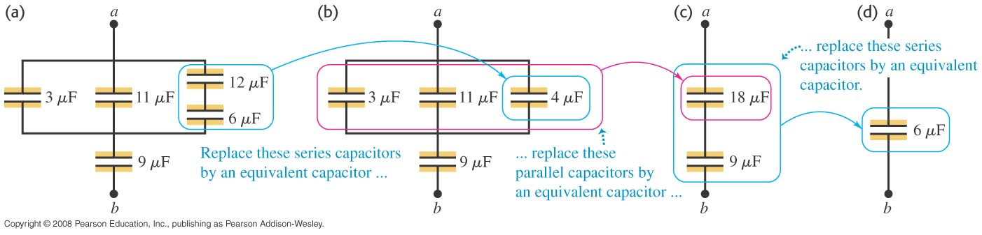
Calculations of capacitance
Example 24.6, a capacitor network:
Find C eq?

Slide 12
Energy stored in a capacitor
The potential energy stored in a capacitor is
U = Q²/2C (in JOULES)
U increases with more stored charge;
U is less for fixed charge on a larger capacitor
U = Q²/2C but C = Q/V…. so
U = 1/2 QV.
U = Q²/2C and Q = CV … so
U = 1/2 CV²

Slide 13
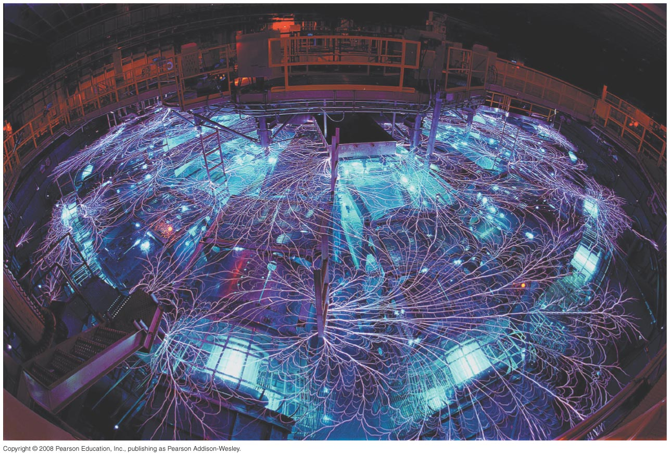
Energy stored in a capacitor
The potential energy stored in a capacitor is
U = Q²/2C = 1/2 CV² = 1/2 QV.
The capacitor energy is stored in the electric field between the plates. The energy density is u = 1/2 ε₀E².
The Z machine shown below can produce up to 2.9 × 10¹⁴ W using capacitors in parallel!

